Slide 1
FOOD ORDERING SYSTEM
K225346_ OSASMA SHAMIM
K225347_HASEEB UR REHMAN ANSARI

Slide 2
INTRODUCTION
This system is developed to reduce the problems in the current practicing system.
It overcomes the challenges of erroneous data during the ordering of item, Payment and Order confirmation.
It can assist organizations in strategic planning.
It can equipped any organization with the right level of information for their future goals.

Slide 3
INTRODUCTION
It can help the organizations to concentrate on working other productive activities rather than worrying about record keeping.

Slide 4
OBJECTIVE
The main goal of designing this project is to reduce manual work.
It encompasses all details and information about Food items, Payment and Confirmed Orders.
It also tracks all the details of Customers as well.

Slide 5
MOTIVATION
Our motive is to “Automate Business Process Of Ordering Food”.
We have computerized all the steps for ordering the food online.
To assist the organizations in reporting and presenting the data in more comprehensive way.

Slide 6
ERD

Slide 7
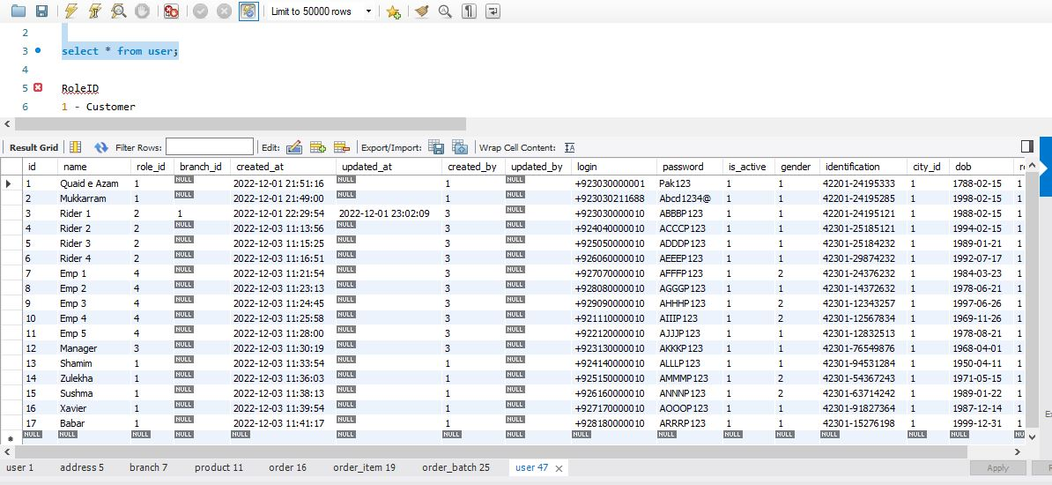
TABLES
USER TABLE

Slide 8
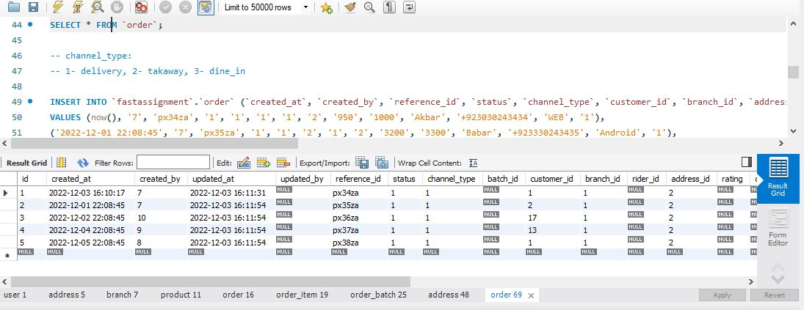
ORDER TABLE

Slide 9
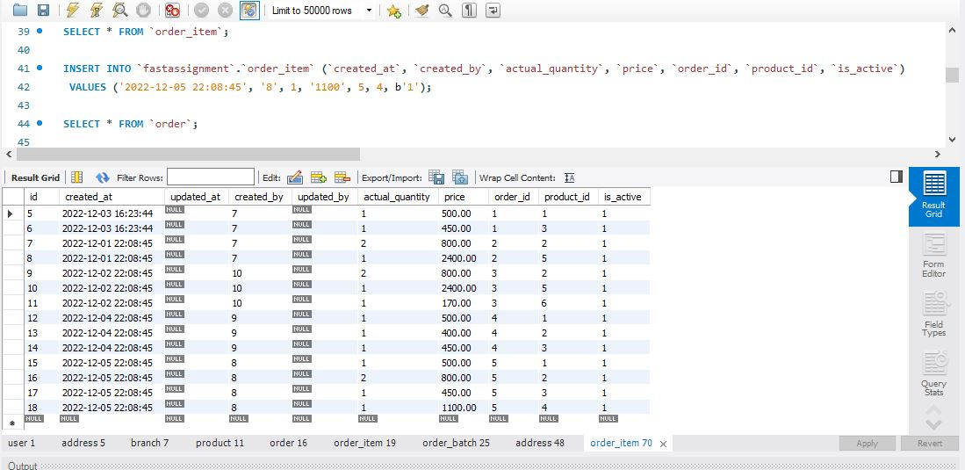
ORDER ITEM TABLE

Slide 10
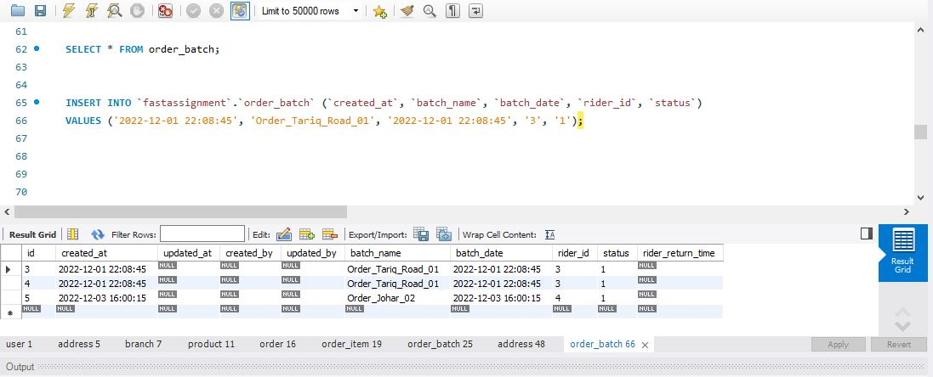
ORDER BATCH TABLE

Slide 11
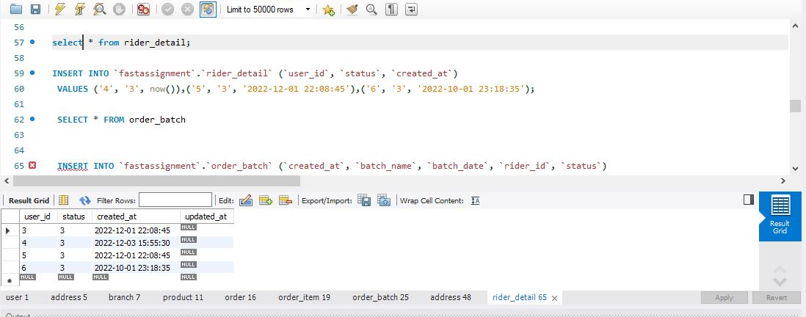
RIDER DETAILS TABLE

Slide 12
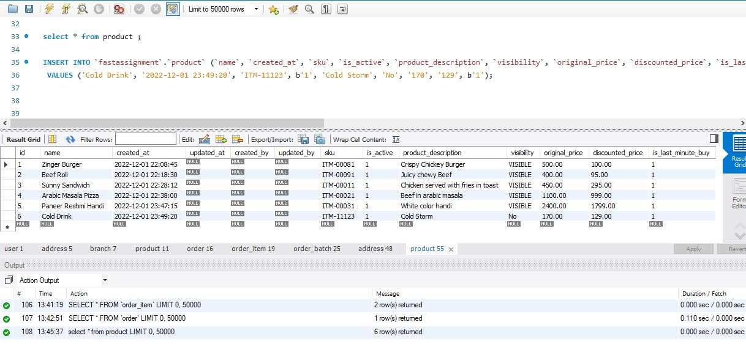
PRODUCT TABLE

Slide 13
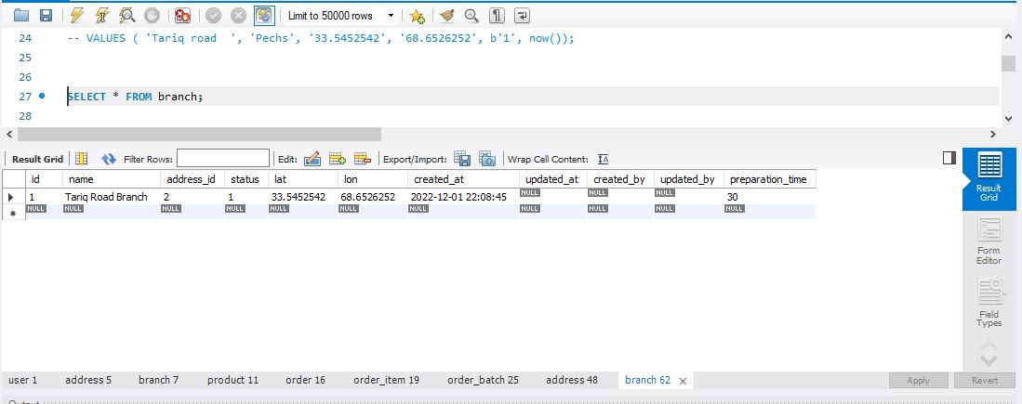
BRANCH TABLE

Slide 14
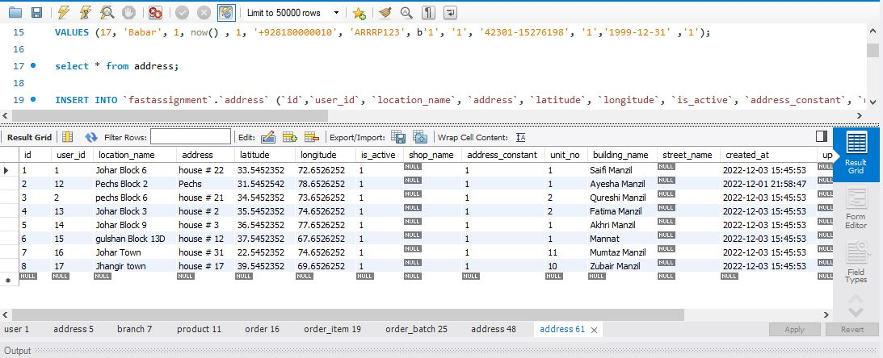
ADDRESS TABLE

Slide 15
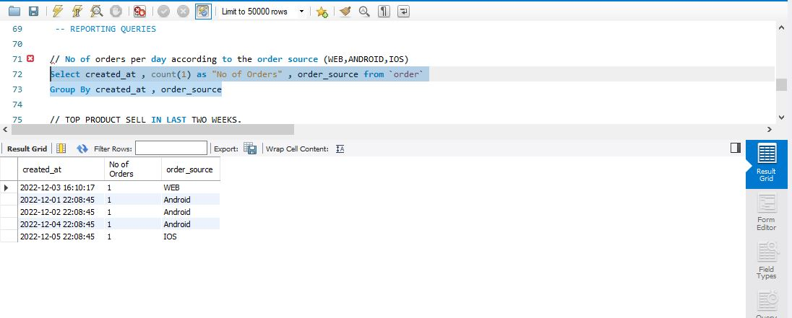
ANALYSIS
NUMBER OF ORDERS PER DAY ACCORDING TO ORDER SOURCE

Slide 16
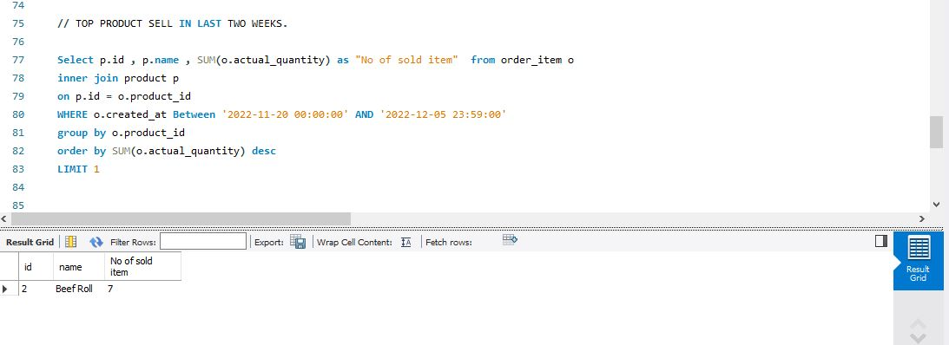
TOP PRODUCT SOLD IN LAST TWO WEEKS

Slide 17
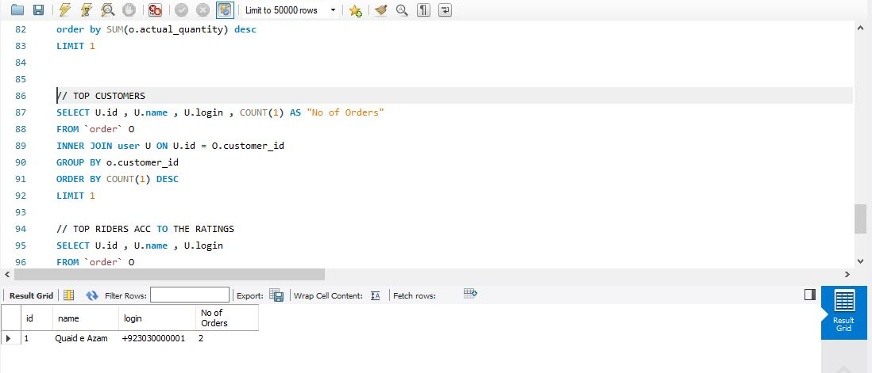
TOP CUSTOMER

Slide 18
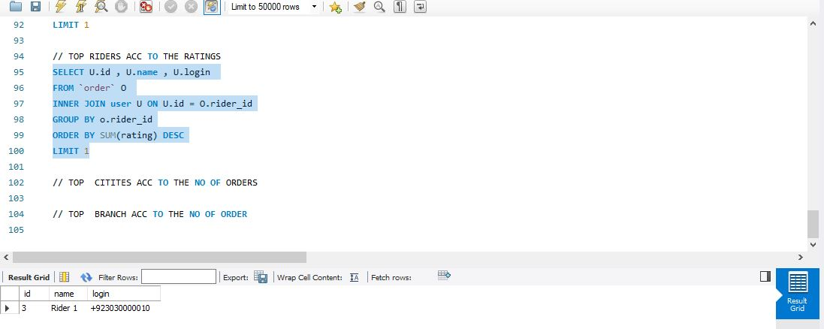
TOP RIDERS ACCORDING TO RATINGS

